Slide 1
Muntinlupa Baptist Church Reports Tracking System
Software Development
Julian Louise Acuna
Gener Paolo Sagun
Angelo Charles Sia

Slide 2
Background of the Client
Muntinlupa Baptist Church is a southern baptist church located at Summit Circle, Bayanan, Muntinlupa. It continues to pursue its vision to honor and glorify God through the ministry of witnessing and evangelism reaching the world for Christ.
CLIENT PROFILE
Client | Muntinlupa Baptist Church
Client Representative | Sergie Val Besana Espolong
Work | Nexus as Applications Consultant, Developments Operations Team and Technical Support department
Contact | 09053799677
Email | sbespolong@nexustech.com.ph

Slide 3
Background of the Project
The system is giving the client/company ease of access to management of operations such as;
To be able to reach out to our members and people inside and out of the country.
To be able to monitor our future out of town and country missions.
To be able to update our members with the current events just with the use of the web.
To be able to manage the organization's data and information with more ease.

Slide 4
Scope of the Project
Scope
1. Automated reports tracking system
2. Automated attendance records
3. Automated prayer request
4. Automated members' record
5. Automated events' record

Slide 5
Iterations 1 and 2
In the iteration 1 the project team discussed about the FRONTEND of the system. These are the FRONTEND features of the Web Application;
Member Page
Home, About and Contact Page
Prayer request Creation Page
Events Schedule Page

Slide 6
Iterations 1 and 2
Iteration 2 (BACKEND)
Admin Page
Creation of Event
Creation of Prayer
Creation of Tithe

Slide 7
Client Presentation Feedback
Iteration 1 Feedback Form
Iteration 2 Feedback Form
Additional requirements of the client to the system:
Low and High priority in Events Page
Sorting of Events
Contact verification sent of email inquiry to the church

Slide 8
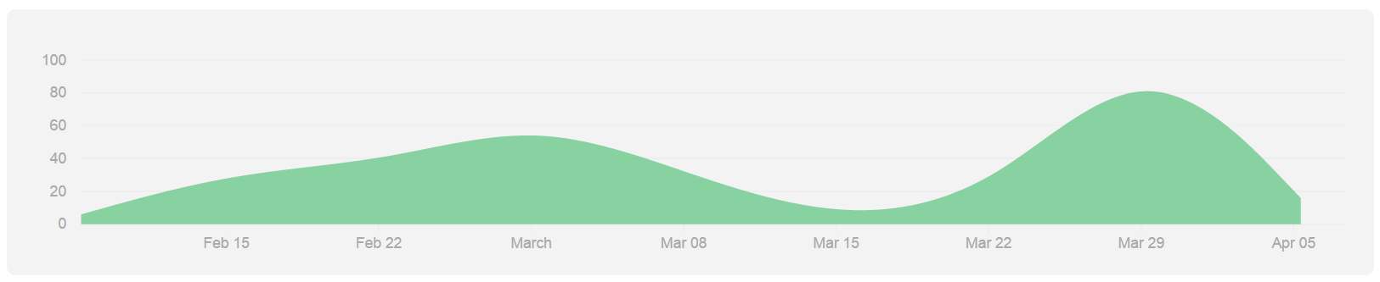
Github repository all (Feb 8, 2015 – Apr 7, 2015)

Slide 9
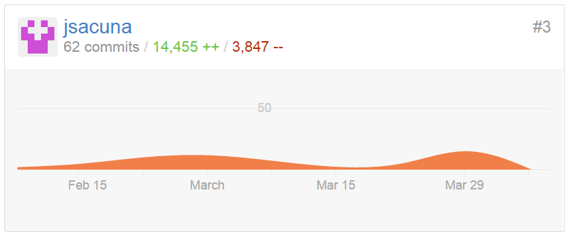
Julian Acuña (Feb 8, 2015 – Apr 7, 2015)

Slide 10
Group Contribution
Julian Acuña
Modules:
- Contact Us Page
- Prayer Request Page (Model and CRUD, Frontend and Backend)
Added Extension:
- Date Picker widget, Schedule of Prayer (Backend and Frontend)
Added Features:
- Prayer Segregation(Public and Private)

Slide 11

Most recent commits

Slide 12
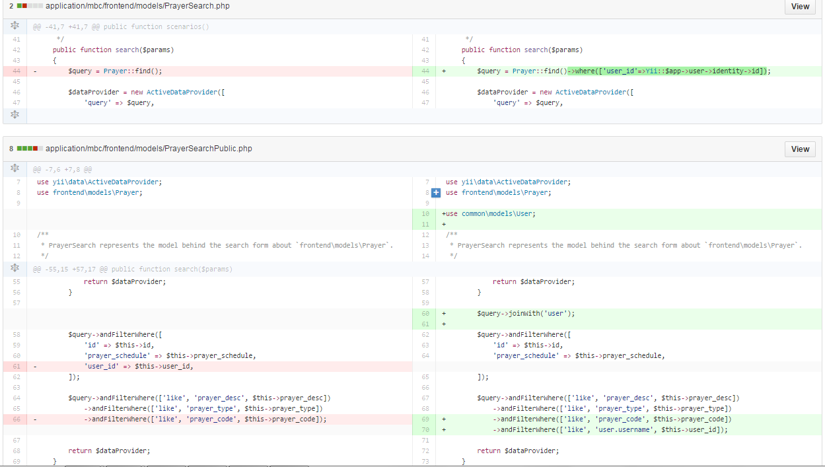

Slide 13
Difference previous to current
Julian Louis San Gabriel Acuña

Slide 14
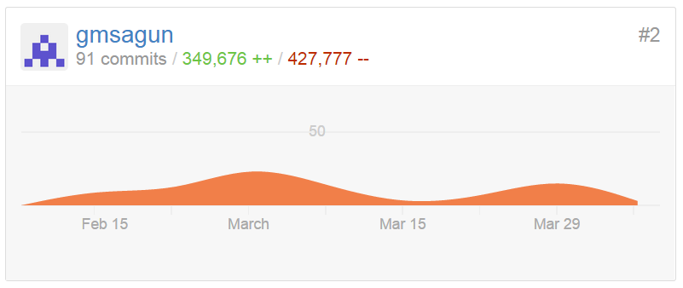
Gener Paolo Sagun (Feb 8, 2015 – Apr 7, 2015)

Slide 15
Group Contribution
Gener Paolo Sagun
Modules:
- About Page
- Event Page (Model and CRUD, Frontend and Backend)
Added Extension:
- Date Picker widget of Event dates (Backend)
- Date Picker sorting of events date (Frontend)
Added Feature:
- 10 Events Per page (View Frontend & Backend)
- Session in Event Page (Backend)

Slide 16
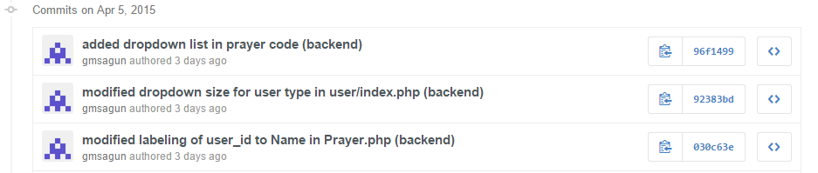
Most recent commits

Slide 17
Difference previous to current
Gener Paolo Sagun

Slide 18
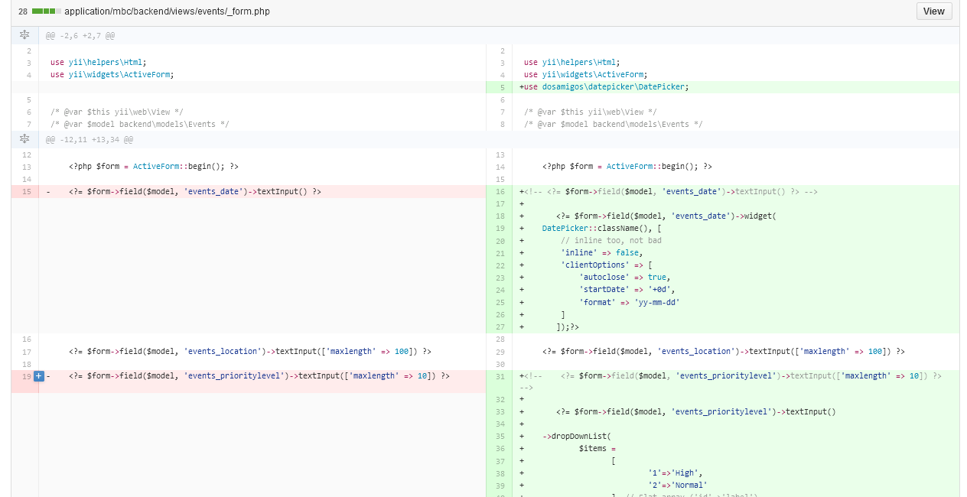

Slide 19
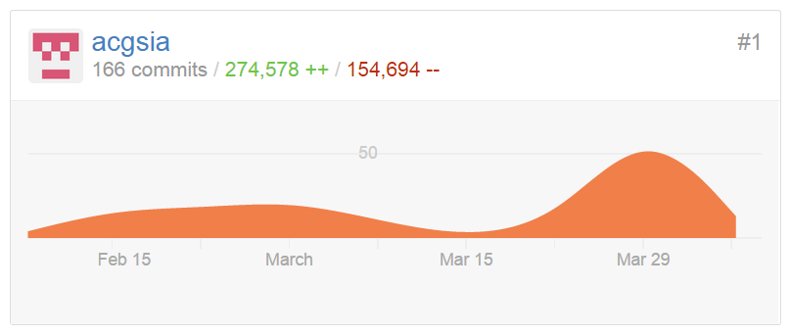
Angelo Sia (Feb 8, 2015 – Apr 7, 2015)

Slide 20
Group Contribution
Angelo Sia
Modules:
- Database
- Layout Page (Including Navigation Bar and Footer)
- User Management (Model and CRUD, Backend)
- Tithe (Model and CRUD, Backend)
Additional Features:
- Restriction in Backend (Admin Only Page)
- Added Plugin Calendar (Tithe)
- Web site icon
Client Suggestion:
- 10 items per Page (Tithe)
- Contact Us Page sending email

Slide 21
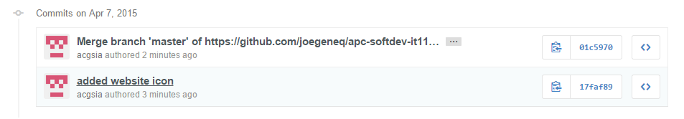
Most recent commits

Slide 22
Difference previous to current
Angelo Sia

Slide 23
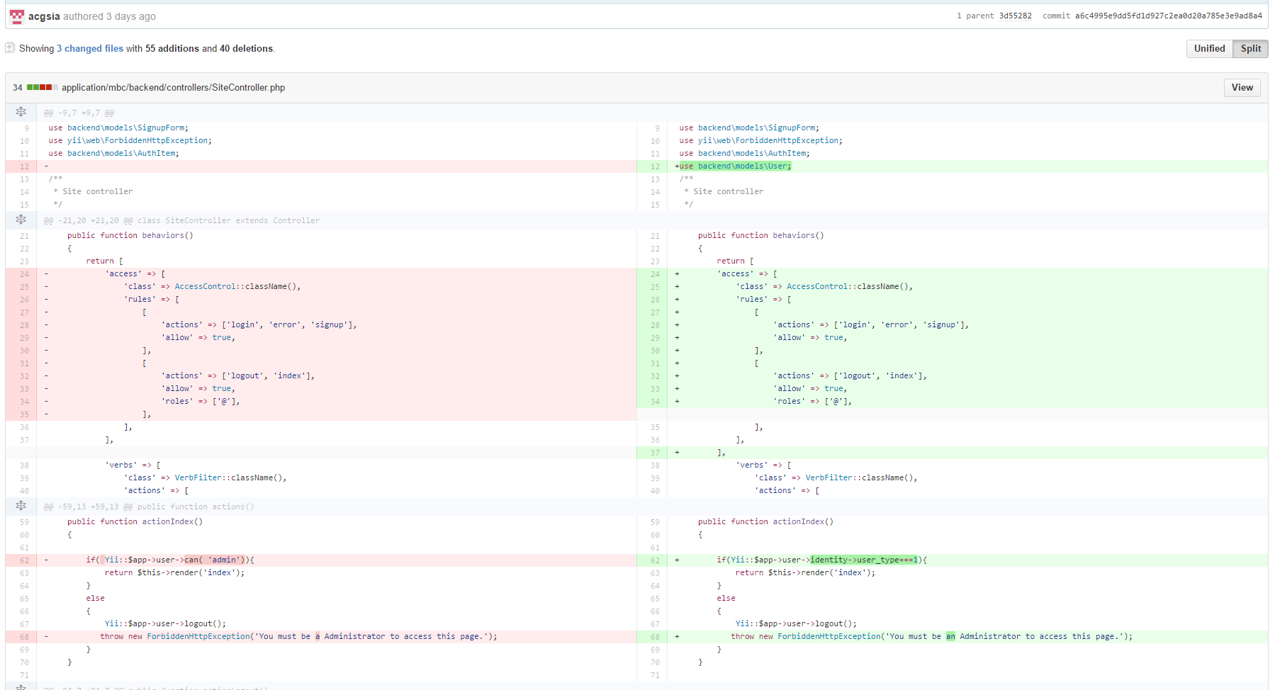
Difference previous to current

Slide 24
PROTOTYPE
DEMO

Slide 25
Project Status
These are the functional requirements in the system;
Member - they are the user of the system which has been approved by the church leaders.
Activities: Member can log-in with their registered account .
Member can view all events of the church organization .
Member can create prayer request to the church leader .
Member can view all public prayer request of other members.

Slide 26
Project Status
Administrator - the person who manage, update and tracks the activity of the user. Activities:
Admin can create, read, update and delete member of the church.
Admin can create, read, update and delete events of the church.
Admin can create, read, update and delete all prayer request of the member.
Admin can create, read, update and delete tithes of the member.

